Slide 1
Welcome to the Data Science Assignment
Housing Project
By Honey Chaudhary

Slide 2
Welcome to the Data science assignment with regarding to the housing project
Then we import the dataset
After that we applying the method to make dataset clear from many things for eg:
How to treat with the null values
What was the correrlation present in the dataset
Here we do the eda process
Romove skewness if present
Converting object columns into integer or float
Applying the best model
Find the best result

Slide 3
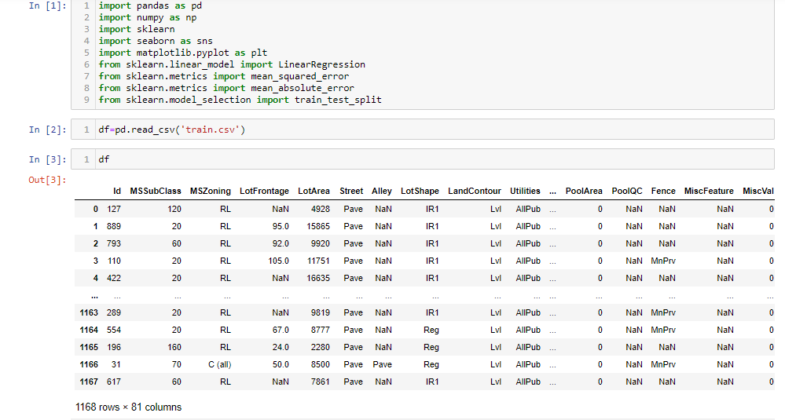
Importing of model and dataset

Slide 4
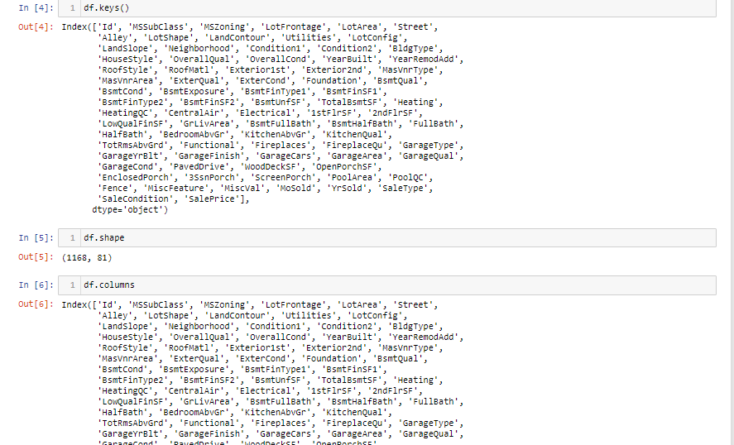
Applying some methods

Slide 5
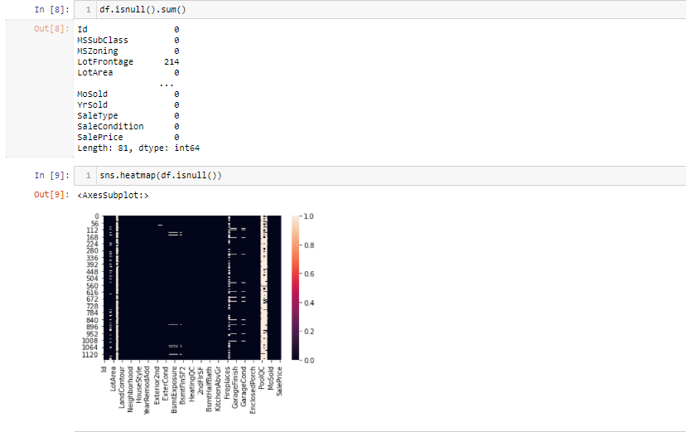
Identifying the null values

Slide 6
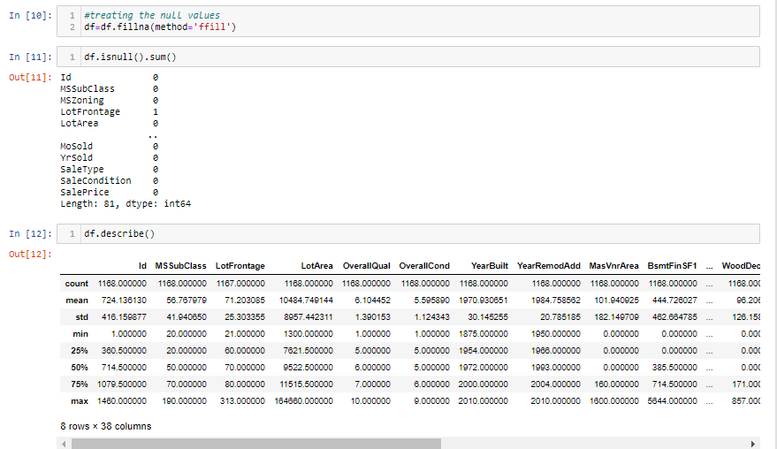
Treating the null values and cheking the mean sd and median from describe method

Slide 7
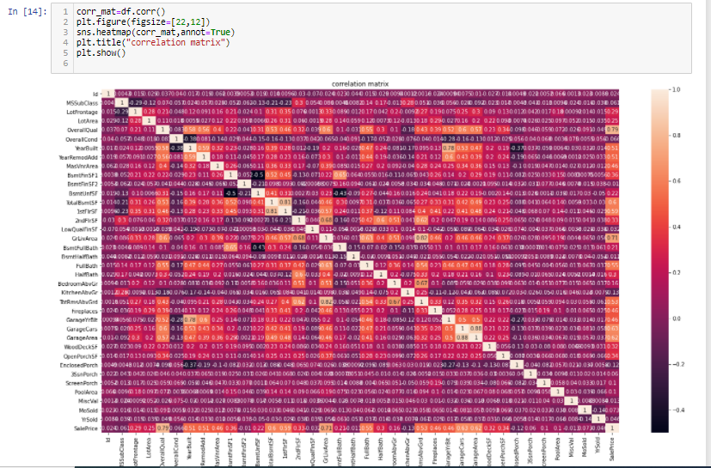
Cheking the correlation on the heat map

Slide 8
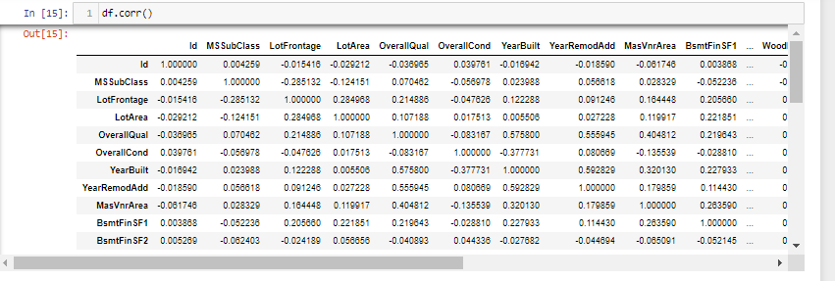
Checking bthe correlation on the table

Slide 9
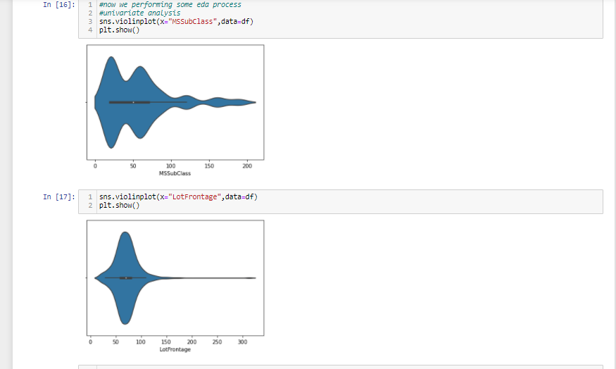
Here we performing the eda process
Univariate analysis

Slide 10
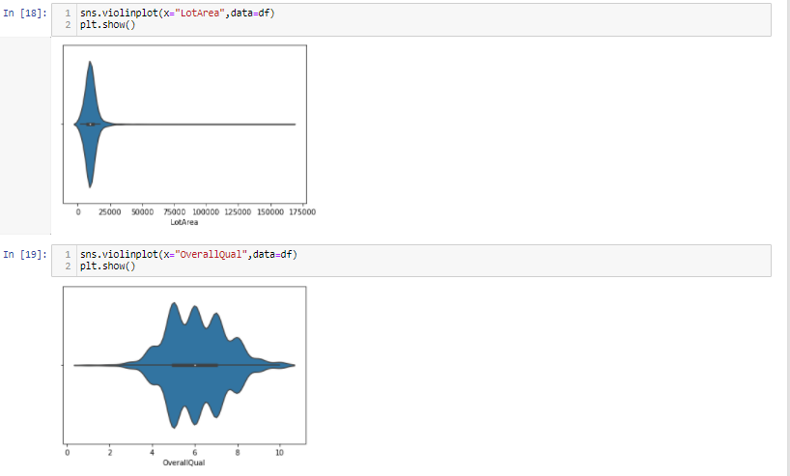
Some more example of univariate analysis

Slide 11
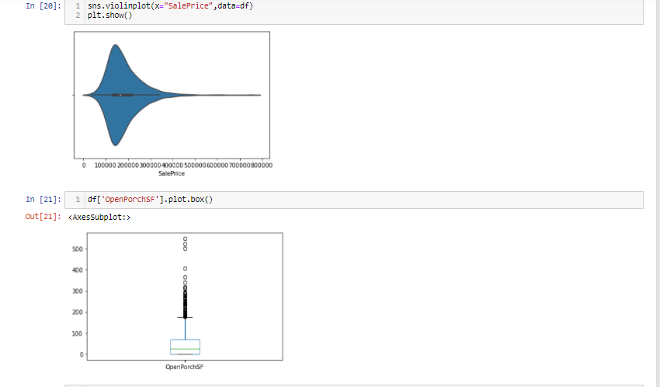
Performing eda process with violin and box plot

Slide 12
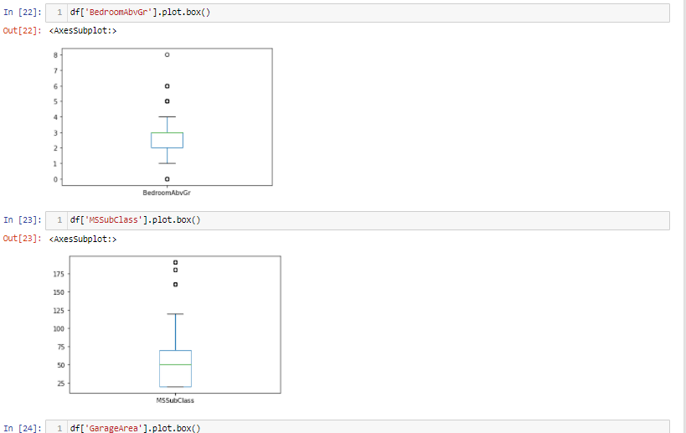
some more Example of box plot

Slide 13
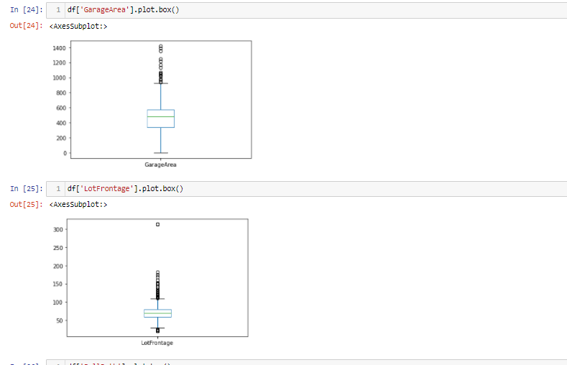
Identify the outliers from boxplot

Slide 14
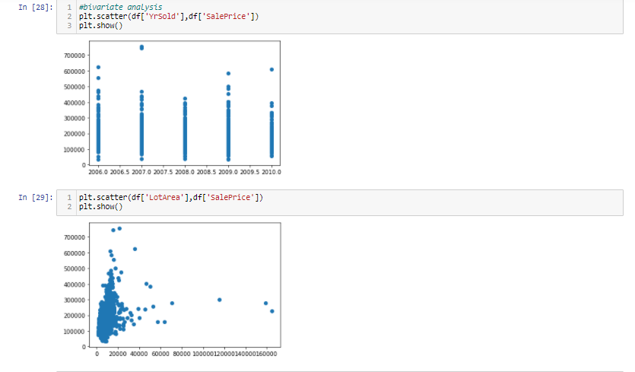
Example of bivariate analysis

Slide 15
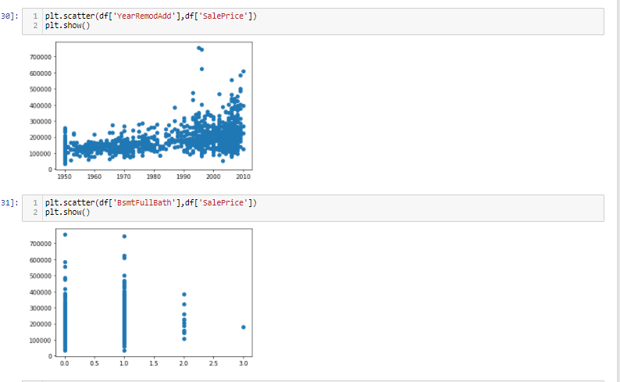
Example of scatter plot

Slide 16
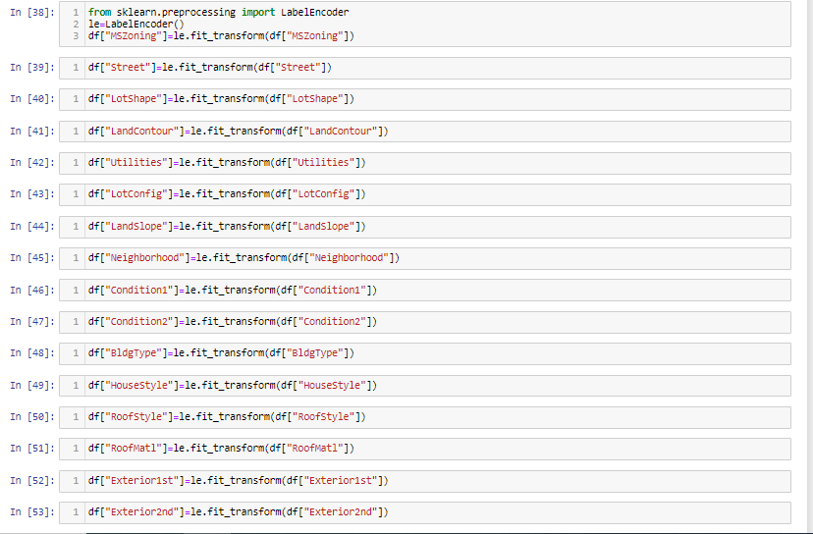
Converting object columns into intergers

Slide 17
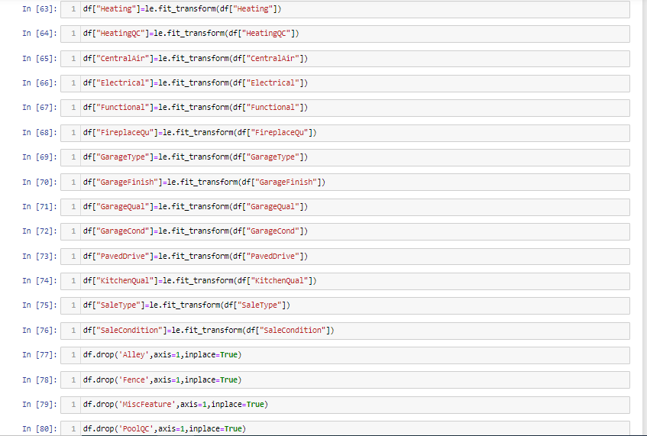
Converting object to integer

Slide 18
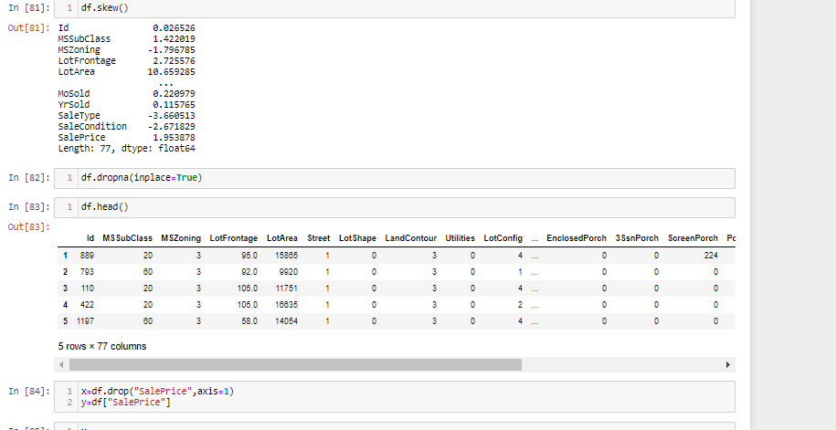
Checking skewness in the dataset and conveting dataset into x and y

Slide 19
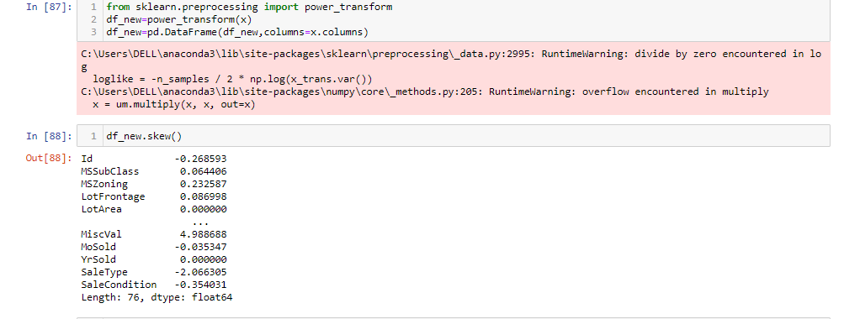
Removing skewness from power transform method

Slide 20
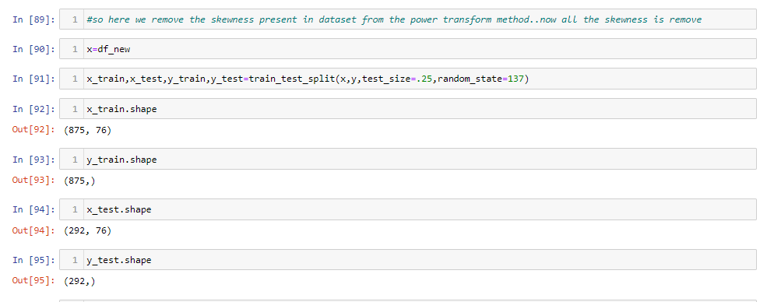
Applying the train test split

Slide 21
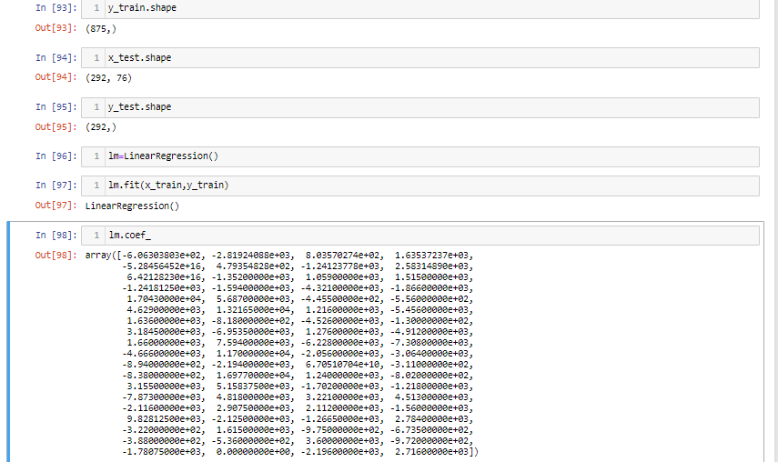
Applying the linear regression model

Slide 22
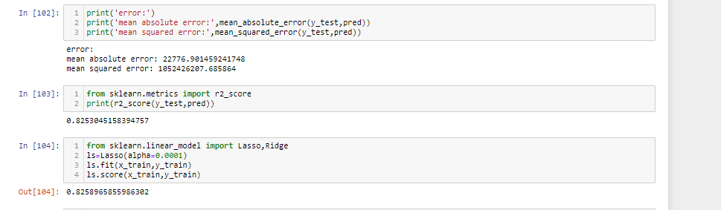
Finding the mean absolute error and mean squared error and applying the lasso and ridge method

Slide 23
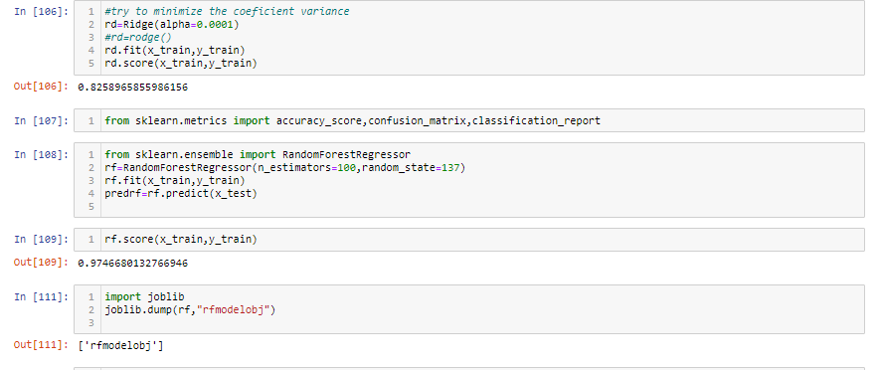
Applying the rendom forest regressor and save the best model

Slide 24

thanks
For
watching

